Slide 1

Harnessing Neurodiversity in Game Development

Slide 2

Introduction
Neurodiversity is about embracing differences in the way people think and learn. By creating inclusive games, we can harness the strengths of all individuals and create a better gaming experience for everyone.

Slide 3
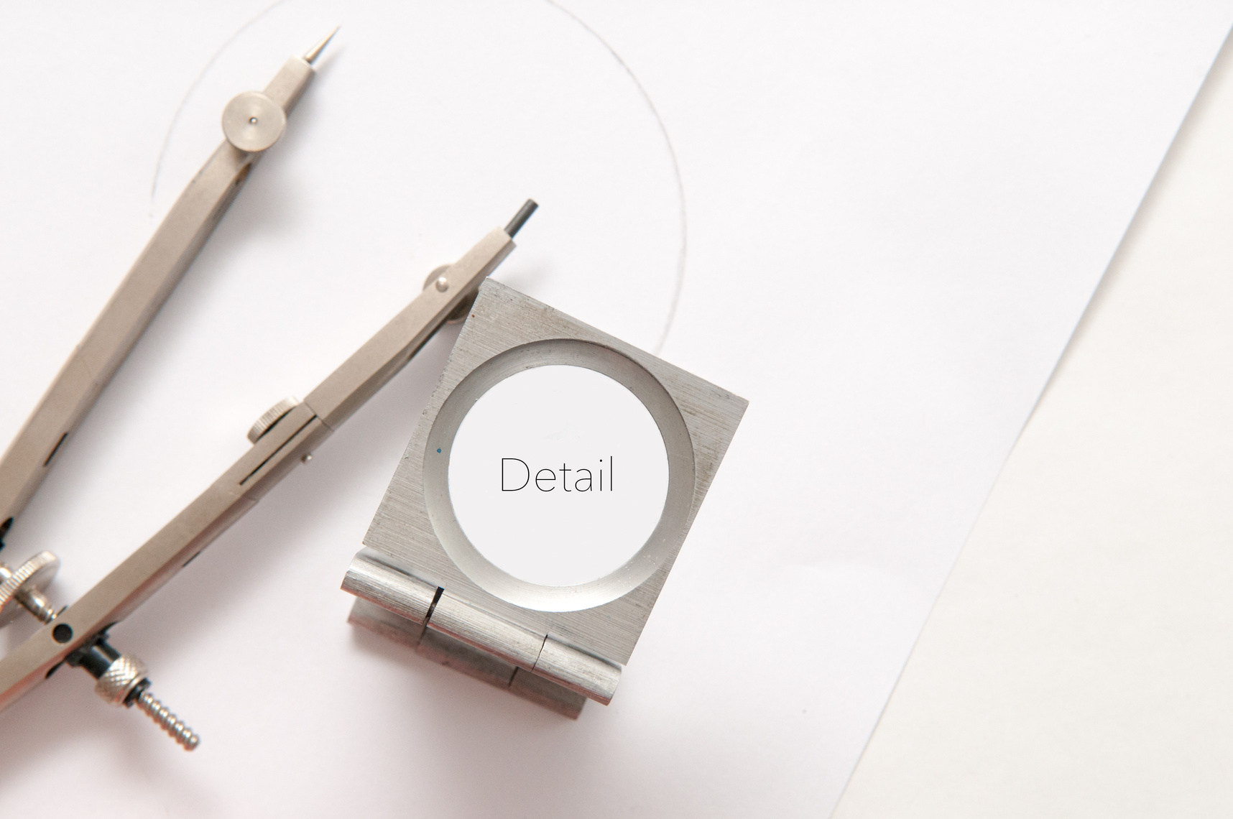

Neurodivergent traits that benefit game development
Hyperfocus on details can lead to more polished game mechanics.
Creativity and thinking outside the box can lead to unique game designs.
Pattern recognition skills can be beneficial in level design.

Slide 4
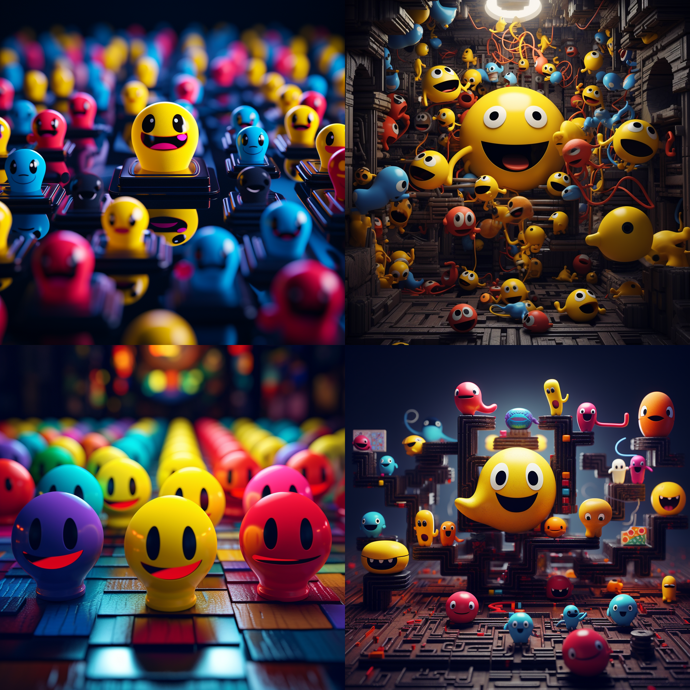

Slide 5

Case Study - Mario Kart
INCLUSIVITY IS KEY TO SUCCESSFUL GAME DESIGN. EMBRACING NEURODIVERSITY IN GAME DEVELOPMENT CAN LEAD TO GREATER CREATIVITY AND INNOVATION.

Slide 6
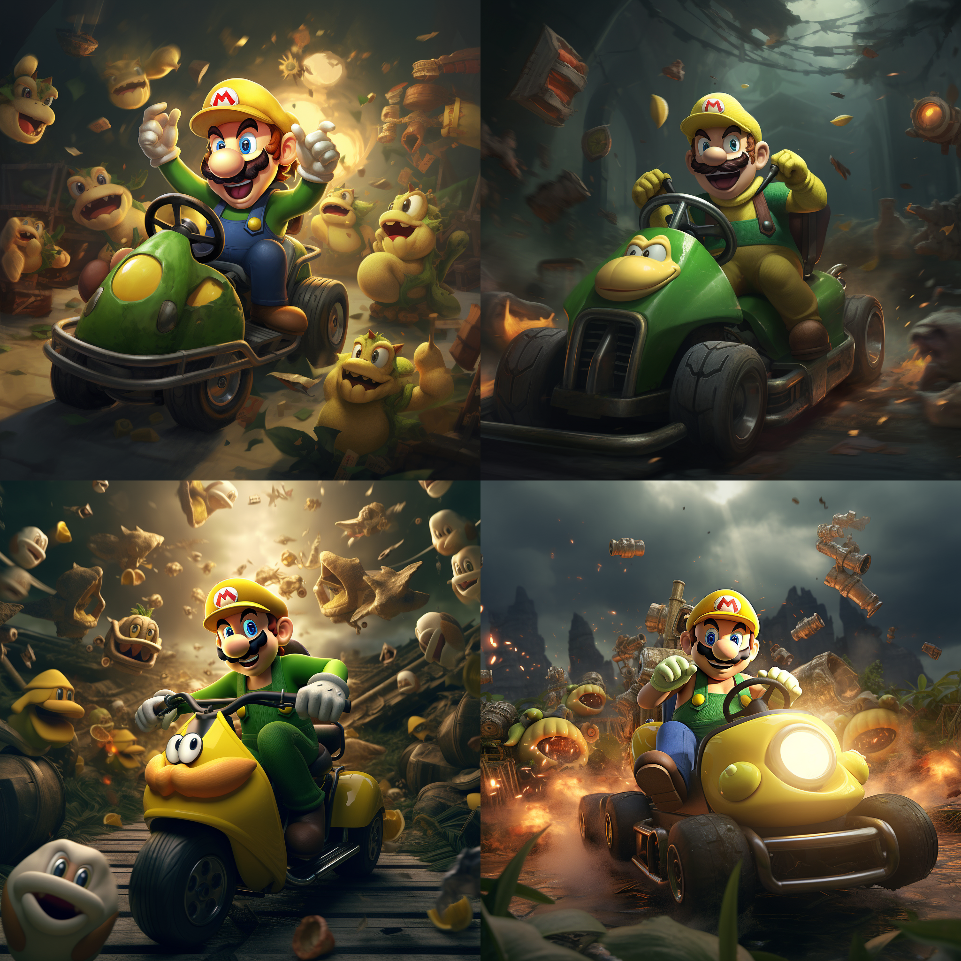

Slide 7

Case Study - Pac-Man
When designing games, embrace neurodiversity. Consider how players on the autism spectrum or with ADHD experience your game.

Slide 8

Case Study - Tetris
Tetris' simple yet addictive gameplay was designed to appeal to players with a range of abilities. Its success shows the value of neurodiversity in game development.

Slide 9

Best practices for harnessing neurodiversity in game development
Use meaningful visual cues to help players navigate the game.
Incorporate different difficulty levels to cater for neurodiverse players.
Implement clear and concise instructions to avoid confusion.

Slide 10
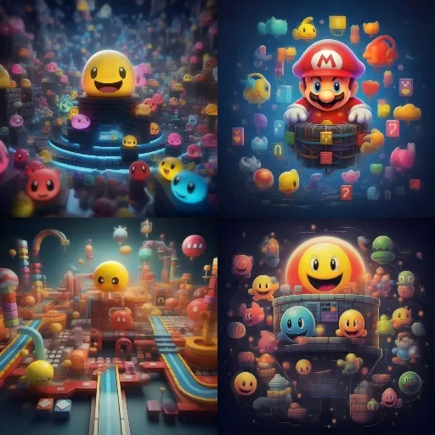

Slide 11
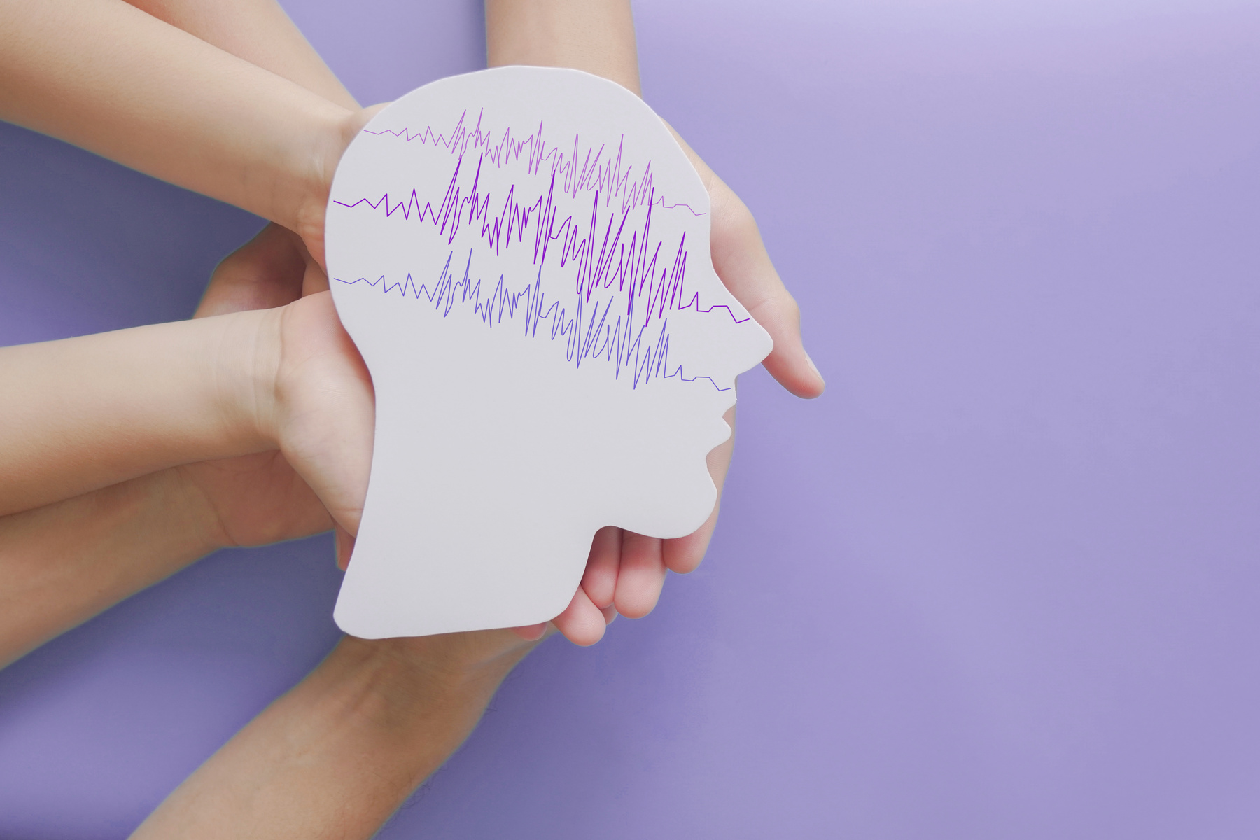
Conclusion and Call to Action
Incorporating neurodiversity into game development leads to more creativity, innovation, and inclusivity. Let's embrace and celebrate differences!

